Slide 1
Edinburgh Business School MBA
Strategic Planning
Module 3
Company Objectives
Instructor: Moataz Darwish, MBA

Slide 2
Contents
Setting Objectives
From Vision to Mission to Objectives
The Gap Concept
Credible Objectives
Quantifiable and Non-Quantifiable Objectives
Aggregate Objectives
Disaggregated Objectives
The Principal / Agent Problem
Means and Ends
Behavioural versus Economic and Financial Objectives
Economic Objectives
Financial Objectives
Social Objectives
Stakeholders
Ethical Considerations
Are Objectives SMART?

Slide 3
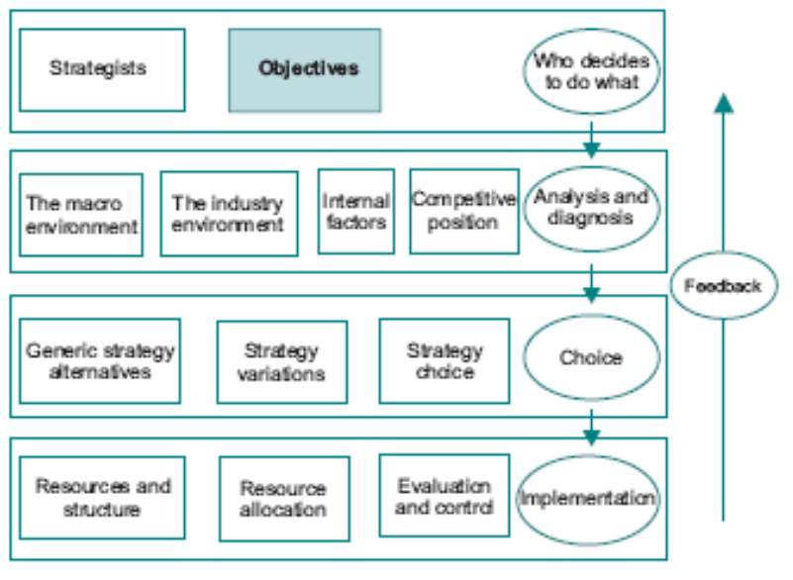
The Model

Slide 4
Setting Objectives
What are we trying to achieve???

Slide 5
Setting Objectives
Any strategic plan is based on the achievement of specified objectives; devising a plan without objectives is a meaningless exercise.
Confusion between plans and objectives pervades many areas of activity.
Some managers become so involved in the planning process that they overlook what it is meant to achieve;
There is a danger that managers confuse the means by which ends are to be achieved with the ends themselves.
  What is to be achieved ought to be differentiated from How it is to be achieved;

Slide 6
Setting Objectives
Since strategy is at least partly concerned with confrontation with competitors, it may not always be advisable for a company to be explicit about its objectives.
  Ex: a company may identify an increased market share in a particular market segment as a major policy objective.
  However, if competitors became aware of this they could preempt the company’s moves by reducing prices, with the result that the company becomes worse off than before.
There is clearly a balance to be struck between informing managers about objectives and ensuring that competitors cannot preempt strategic moves.
It is also likely that in the early stages of strategy formulation it is not possible to identify more than the general thrust of strategy, and at this stage it is not possible to be specific.

Slide 7
From Vision to Mission to Objectives
Defining the Business of the Organization
Deriving the Mission Statement
Disaggregating the Mission
Setting Objectives

Slide 8
From Vision to Mission to Objectives
Vision
Long term view of what the company is about and the markets within which it should be operating (broad thrust).
Mission
  Definition of the business.
  Clearly understood by employees.
  Provide focus for activities.
More tangible
Objectives
What has to be achieved for the mission to be successful.

Slide 9
From Vision to Mission to Objectives
Defining the Business of the Organization
  What business the company is actually in?
  Ex: What business is the Football club in???
  Sport business?
  Entertainment business?

Slide 10
From Vision to Mission to Objectives
Defining the Business of the Organisation
  Ex: What business is the Soft Drinks Company in???
  Soft drinks business?
  Beverages business?
  Cola vs. Pepsi or vs. Juice or vs. Beer or vs. Tang or vs. Gatorade or vs. tonic water or vs. coffee / tea……

Slide 11
From Vision to Mission to Objectives
Defining the Business of the Organization
  Ex: What business is the Soft Drinks Company in???
  Few questions reveal potentially significant differences in business definition:
    1- Does the company control all stages of production or does it purchase all ingredients and merely mix and bottle?
      productive scope of the company, i.e. the extent to which it buys in its inputs and hence how it perceives its own supply chain (make vs. buy bottles)
      Skills set of employees differ;
    2- Does the company control distribution and marketing channels?
      market positioning of the product (brand vs. private label);
    3- Does the company compete in the soft drinks or beverage market?
      breadth and focus of the business definition;
    4- Is the drink a stand alone or is it also intended as a mixer?
      target markets (restaurants, health market, supermarkets…).

Slide 12
From Vision to Mission to Objectives
Deriving the Mission Statement
  how the company intends to operate within that business area.
  factors such as:
    quality
    degree of differentiation;
    geographical area
    segment of targeted consumers
  Ex: soft drinks company’s mission could be:
    To deliver high energy drinks to energetic individuals who care about their health.
    To service the soft drink needs of supermarket chains who need a high quality dependable product to market under their umbrella brand.
    To target teenage consumers who want a brightly colored effervescent drink in an unusually shaped container.

Slide 13
From Vision to Mission to Objectives
Disaggregating the Mission
  modified and applied to individual parts of the organization to ensure, as far as possible, that the focus of functional departments is aligned with the vision of the senior managers.
  Disaggregating the mission to company objectives.
Setting Objectives
  what has to be achieved for the mission to be successful.
  necessary to state the objectives in terms of measurable performance targets;
  Objective setting introduces accountability into the business of pursuing the company vision,

Slide 14
Contents
Setting Objectives
From Vision to Mission to Objectives
The Gap Concept
Credible Objectives
Quantifiable and Non-Quantifiable Objectives
Aggregate Objectives
Disaggregated Objectives
The Principal / Agent Problem
Means and Ends
Behavioural versus Economic and Financial Objectives
Economic Objectives
Financial Objectives
Social Objectives
Stakeholders
Ethical Considerations

Slide 15
The Gap Concept
Performance gaps shows what has to be accomplished in order to achieve.
The gap concept is concerned with the difference between expected and desired future states.
Two steps:
  1- desired future state (new products, market shares, profitability…).
  2- the state the company is likely to be in at that time if no changes to strategy are made.
  The difference between the expected and the desired state is the Performance Gap

Slide 16
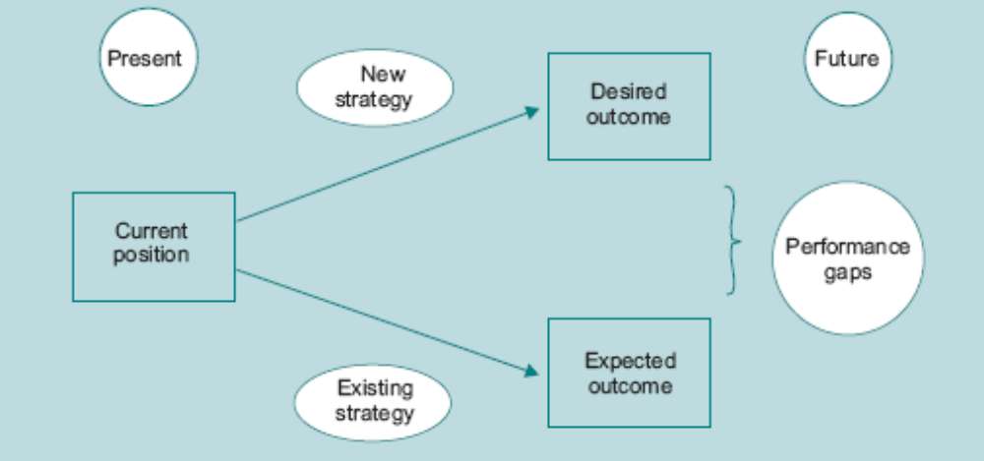
The Gap Concept

Slide 17
The Gap Concept
Goal
profits, growth…
Gap
Outcome
Current Path
TODAY
Time
Outcome is on the vertical axis. It could be anything, profits, growth, etc.
Time is on the horizontal axis. Strategy starts by determining where we are today relative to where we have been. Given this current path you can anticipate where you will be in the future.
Strategic planning defines the goal of where you want to be and determines the path to get you there. It answers how you close the gap.

Slide 18
The Gap Concept
The gap can be determined once objectives have been set in terms of desired future states.
Since the gap has to be closed in order to achieve the objective, or the future desired state of the company.
The closing of the gap could be defined as the company objective.
  This is not quite consistent with the definition of an objective, since the closing of the gap is a means to an end, not the end itself.
It may turn out that identification of the gap results in a modification of the company objective
  because it transpires that the gap cannot be closed;
  there is continual feedback between objective setting and gap analysis.

Slide 19
The Gap Concept
The problem facing planners is to make projections of total company performance; this can be complicated, and is typically carried out by using the scenario approach.
A scenario comprises a series of ‘what if’ projections, and should not be confused with a forecast.
For example, if the desired future state involved achieving a 3 per cent higher market share in two years,
  a scenario could be investigated whereby marketing expenditure would be increased by 30 per cent during the next two years. The resulting scenario would include the impact on:
    cash flow,
    the likely effect on market share,
    the reaction of competitors,
    and the identification of what additional measures might be required, such as a price reduction and increased productive capacity.

Slide 20

The Gap Concept
A scenario is actually a carefully argued narrative about a particular way in which the future might take shape.
It is therefore a story about what could happen if particular assumptions hold true.
It is not an attempt to say what will happen.
Instead, the idea is to:
  compare the scenario’s implications with the implications of rival scenarios
  and then examine the costs of being prepared to cope with these possible futures.
The approach is usually associated with Shell International Petroleum Company…1973 oil price.

Slide 21
The Gap Concept
Scenario case

Slide 22
The Gap Concept
Once the gap has been identified, three questions can be tackled:
  Does the gap arise because of external or internal factors?
  Does the company have potential resources to close the gap?
  Can a strategy be developed which will close the gap?
Outcome of gap analysis might be that there is substantial difference between expected and desired states.
Gap analysis can reveal that the company is not actually moving in the direction desired.
Closing such a gap may imply substantial redeployment of resources and changes in marketing strategy.

Slide 23
The Gap Concept
External versus Internal Gap Factors
Gaps and Resources
Gaps and Incentives

Slide 24
The Gap Concept
External versus Internal Gap Factors
  Two reasons for the emergence of gaps, factors:
    1- Outside control of the company (reduction in market
    size and product prices; aggressive competitor actions or government
    intervention…)
    The fact that gaps are due to external causes does not necessarily mean that the company can do nothing about them, but those instances where they cannot be fully counteracted need to be recognized.
    2- Within the control of the company (mobilisation of resources)
    current allocation of resources is not consistent with achieving the future desired state (cut back in areas and increase in others)
    resources available to the company are insufficient in quantity or quality to achieve the desired objective.

Slide 25
The Gap Concept
Gaps and Resources
  It is not just the company’s ability to acquire and deploy resources which is important, but the timing involved.
    By combining gap analysis with the dynamic scenario approach it is possible to estimate the timing of resource acquisition and reallocation required to achieve a desired future state.
  By taking a view on the future course of events it is possible to identify Critical Success Factors (CSF).
  This helps to avoid the emergence of production bottlenecks, skill shortages and financial headaches which typically beset companies during the process of change.
  can make it possible to identify when commitment to a course of action can be delayed; the chance to hedge positions can have significant implications for success and failure.

Slide 26
The Gap Concept
Gaps and Incentives
  One reason for the existence of a gap is that the current incentive system is consistent with what is expected to happen as opposed to what is desired.
  This can be difficult to achieve.
To incentivise or not to insentivise? That is the question

Slide 27
Contents
Setting Objectives
From Vision to Mission to Objectives
The Gap Concept
Credible Objectives
Quantifiable and Non-Quantifiable Objectives
Aggregate Objectives
Disaggregated Objectives
The Principal / Agent Problem
Means and Ends
Behavioural versus Economic and Financial Objectives
Economic Objectives
Financial Objectives
Social Objectives
Stakeholders
Ethical Considerations

Slide 28
Credible Objectives
Not an activity which can be carried out in isolation.
Dependent on:
  past decisions
  state of the company at the moment
  perceived market opportunities.
Setting realistic objectives is a dynamic process - constantly under review.
Loose objectives = wishful thinking
Objectives must be: relevant and achievable to the managers involved
This is where gap analysis can play an important role.
  For example, an objective may not appear to be feasible at the present, but in terms of gap analysis it can be demonstrated that it is achievable in relation to where the company is expected to be in the future.

Slide 29
Quantifiable & Non-quantifiable Objectives
Companies typically express objectives in terms of a number of components or characteristics, ex:
  being associated with high quality products
  having a happy and stable workforce
    Quality / Happy? non-quantifiable! Subjective!
  having a dominant market share
  generating a specified rate of return on investment.
Importance of intangible factors.
  The handling of intangibles in cost benefit analysis has lessons for managers who wish to incorporate non-measurable components into company objectives.
  Ex: new by-pass road.

Slide 30
Aggregate Objectives
Aggregate = applies to overall company performance, size, target markets, financial structure and so on.
Aggregate objectives are sometimes indistinguishable from mission statements
May be expressed in vague terms such as ‘being in the transport business’ or ‘being innovative and quality orientated’;
One way of combining these is to use the notion of maximising shareholder wealth (or shareholder value)

Slide 31
Disaggregated Objectives
Converting aggregate objectives to a series of objectives for managers at lower levels raises many difficulties.
A prerequisite is to identify the individual objectives which must be achieved in pursuit of the aggregate objectives.
Example:
  telling a sales force manager that the corporate objective is to achieve 15% ROR on investment.
  Instead, the manager needs to be told what level of sales is consistent with the objective of a 15 per cent rate of return.
  may attempt to maximise the sales in response to general objective
  the optimum corporate strategy may be to maintain market share at the current level and takeover a key competitor.

Slide 32
Disaggregated Objectives
Example of how objectives might be set at different levels, partly determined by the constraints faced by the company at the corporate level, is as follows:
CORPORATE OBJECTIVE
  Achieve target ROI →MEANS: Maintain market share / Takeover competitors→ CONSTRAINTS: Existing productive capacity / Sharply increasing marginal cost / Current high debt ratio
SBU OBJECTIVES
  Maintain existing market shares / Control costs → CONSTRAINTS: No investment capital
SALES OBJECTIVES
  Maintain market shares / Cut marketing expenditure
PRODUCTION OBJECTIVES
  Increase productivity
  Reduce inventories

Slide 33

Disaggregated Objectives
Objectives of headquarters X individual managers.
  Ex: sales manager see career prospects being dependent on maximising sales
  Marketing manager may fight against a cut in marketing expenditures
  Principal Agent Problem
managers X managers.
  SALES OBJECTIVES → Increase market share
  PRODUCTION OBJECTIVES→ Reduce inventories
  MARKETING MANAGER → High inventory level

Slide 34
Principle Agent Problem
Example
CEO - remuneration package includes a bonus for growth in current profits;
  may reduce expenditure on R&D
The devil is in the incentive systems

Slide 35
Principle Agent Problem
In takeover bids
  outsider spotted opportunities for increasing shareholder wealth
  shareholders cannot ensure that their managers act efficiently;
The UK in the years following the privatization of huge nationalised industries including gas and water utilities.
British Gas (high degree of dissatisfaction + large salaries)
It proved impossible for the small shareholders to censure the management board because the large institutional investors supported the existing management.

Slide 36
Means and Ends
What is to be achieved ought to be differentiated from
How it is to be achieved;
Can lead to confusion as to the nature of objectives.
Ex:
  objective of 15 per cent rate of return on investment.
  happy and stable workforce, or by being associated with high quality products…IS means to an end.
  Cause and effect

Slide 37
Behavioral vs. Economic & Financial Objectives
Two approaches
  Economists approach that objectives must be primarily expressed in economic or financial terms, otherwise
    not related to market conditions,
    do not indicate the efficiency of the resource conversion process,
  Behaviourist approach argues that effective interpersonal processes greatly improve the probability of success for the company as a whole;
  There is no right or wrong approach to setting objectives

Slide 38
Behavioral vs. Economic & Financial Objectives
A company which does not meet minimum economic and financial objectives may not stay in business long enough to be rescued by behavioural attributes.

Slide 39
Economic Objectives
Economic vs. Financial ?!?!
Economists
  taken into account motives which cannot be expressed in financial or monetary terms.
  First economic Question: What is being maximised?’
  The idea of maximisation - additional resources devoted to the achievement of any particular objective are likely to yield diminishing returns after some point.
  The notion of maximisation combines an objective with a resource allocation implication.

Slide 40
Economic Objectives
Profit maximization is that it is an unattainable ideal
The problem of bounded rationality, and its solution known as ‘satisficing’:
  The world is actually too complex to be understood by the human brain.
  It is impossible to take into account the complexity of real life - ‘bounded rationality’;
  the decision maker is rational given the information available, but is quite aware that more information could be obtained at a cost.
  Decision makers act in accordance with profit maximisation, but it is impossible to reconcile profit maximisation with bounded rationality.
  ‘Satisficing’ was invented to reflect the fact that decision makers collect information and defer selecting a course of action until the costs of further delay and information collection are considered to be greater than the potential benefits of searching out a better option.
  Thus rather than simply attempting to maximise profit, the decision maker satisfies himself that there is nothing more to be gained from further delay.

Slide 41
Financial Objectives
The application of financial concepts makes it possible to quantify the profit maximisation objective.
Outline of the main financial concepts…
  Discounting and Present Value
  Net Present Value
  Capitalised Value
  Choice of Interest Rate: The Cost of Capital
  Return on Investment
  Shareholder Wealth

Slide 42
Social Objectives
Objectives include:
  minimization of pollution
  creating employment opportunities for the disadvantaged
This view was strongly criticized by Friedman which is consistent with the view of Adam Smith:
  result in a misallocation of resources so that everyone ends up worse off.
  interests of society as a whole are served by the self seeking actions of individuals

Slide 43
Social Objectives
CSR article and examples

Slide 44
Social Objectives
The arguments against incorporating social objectives
  lack of efficiency criteria.
  how much of its scarce resources to devote to any particular end.
  whether this allocation of resources is efficient.
  may generate a paternalistic attitude in large companies which is contrary to the concepts of freedom of action upon which the notion of the market system is based.
  Self interest of the shareholders.
  compete against rivals who are pursuing a purely profit maximising set of objectives; this means that the company will have higher relative costs.
  the company goes out of business and shareholders lose their wealth, the attempt to achieve social objectives becomes rather pointless and self defeating.

Slide 45
Social Objectives
The underlying issue here is what is referred to by economists as ‘efficiency versus equity’.
  The efficiency issue is concerned with maximizing the output of goods and services.
  The equity issue is how the output should be distributed among members of society.

Slide 46

Stakeholders
A variety of individuals and groups have an interest in the organisation and the way in which it is managed, and those individuals and groups are categorised as the stakeholders.

Slide 47
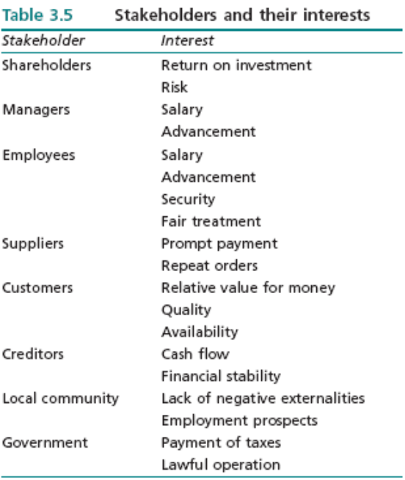
Stakeholders
Each stakeholder has a different type of interest in the company.
Not necessarily expressed in financial terms.
Possibility of conflicts of interest.

Slide 48
Stakeholders
Two distinct issues:
  which interests are most important (how stakeholders feel the company should be run)
  the influence which stakeholders have on the operation of the company (how the company is actually run)

Slide 49
Stakeholders
Mapping Stakeholders
  stakeholders needs to be identified and prioritised.
  stakeholder analysis can be mapped
  precise location is a subjective judgment, but identifies clusters of stakeholders, who may therefore require a similar degree of consideration, and outliers.
  Any movement can be tracked over time identifying changing power structure confronting the company.
Stakeholder Interests: The Priorities
Stakeholder Influence

Slide 50
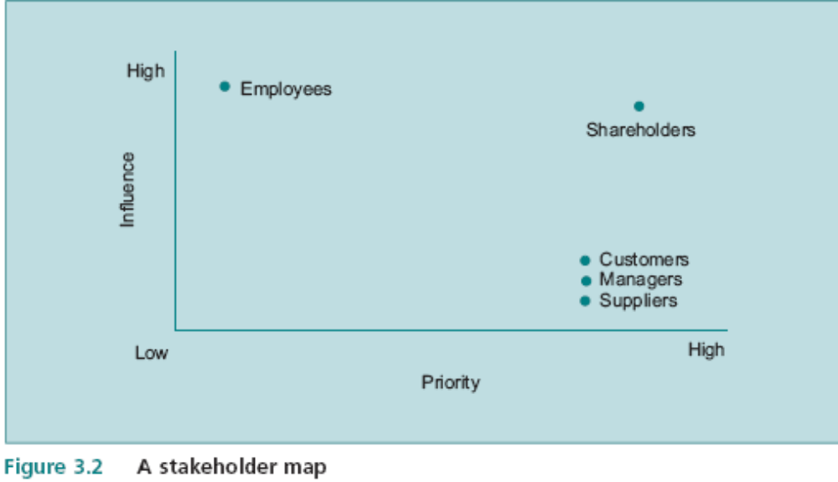
Stakeholders
(Interests)

Slide 51
Ethical Considerations
In the complex world of business it is usually very difficult to define appropriate moral codes of conduct.
Moral issues are never simple to resolve;
Many management issues are related to moral dilemmas, but these are often to do with society generally rather than the individual company.
Some companies impose a code of ethics on their employees, such as never accepting bribes.

Slide 52
Ethical Considerations
Ex.
Britain during the eighteenth century children were employed to work in factories and mines in very poor conditions; if society in general was morally satisfied with this arrangement, in what sense was the individual employer acting in an immoral fashion?
Wearing of fur coats.
  Does it matter if tigers disappear? Species are eliminated all the time, so what is so special about big cats?
  There can be genuine disagreement on the contribution of wearing fur coats to the endangerment of species; what are the real facts relating to wearing animal furs?
  What proportion of the population does it take to decide whether something is immoral or not? It is bad luck for a manager to wake up one morning and find that he is no longer acting in a moral fashion.

Slide 53
Ethical Considerations
Shell attempted to dispose of the obsolete Brent Spar oil rig by sinking it in the North Sea.
  A campaign to boycott Shell petrol stations was instigated, and a group of protestors occupied the oil rig at sea.
Shell announced its intention to invest $2.6 billion in a Nigerian gas plant.
  Environmentalists claimed that Shell had been responsible for most of the pollution in the Niger Delta during the past 40 years, and that this investment would make things even worse.
  Shell came under intense pressure not to proceed with this investment.
the fact is that these ethical issues had a significant effect on the company.

Slide 54
Are Objectives SMART?
Specific: unambiguous and convey what outcome, action or behaviour is required.
Measurable: ability to evaluate achievement using numbers, rates, frequencies or percentages. Ex. 10% market share
Achievable: which employees believe can be reached, leading to commitment to achieve it
Relevant: linked to the organisation’s strategy and achievement of the objective is seen to move the business towards its goals (alignment).
Time-bound: measured against an agreed time frame, not only for the ultimate deadline but for stages along the way. Ex, ‘achieve 10 per cent market share in France after one year and 20 per cent after two years.
in practice it is unlikely that objectives will meet these strict criteria fully.

Slide 55
Are Objectives SMART?
Specific: will tend to be disaggregated; it may be impossible to be specific about aggregate objectives such as ‘improve quality in order to meet increased competition due to technological progress’. It is also important not to confuse the means and ends, given that it is typically easier to be specific about the means than the ends.
Measurable: some objectives are by their nature non-quantifiable, such as ‘to have a happy and stable workforce’. But just because they are not strictly measurable does not mean they should be left out of the equation.
Achievable: different things can appear achievable and credible to different people. The top management team may believe that the company is capable of delivering a successful new market entry into France but this view may not be shared by middle management. It is often possible to identify after the event that the objective was not achievable but this may not be apparent when the
decision is being made.
Relevant: it is clearly important that objectives are aligned with the resource capabilities of the company – or the other way round. The resource based view of strategy discussed in section 1.2.3 highlighted the difficulty of identifying strategic capabilities based on company resources; therefore, it may not always be obvious whether an objective is aligned with strategic capabilities.
Time-bound: while it may appear to add definition to the objectives to relate them to a time scale it has to be recognized that it is impossible to predict the future with any degree of certainty. That is a major defect of the planning approach to strategy identified in section 1.2.3. What can be concluded if 10 per cent market share in France is actually achieved after one year? Perhaps no more than that the guess was right. So we can pose the question: are SMART objectives really smart? There is no doubt that the acronym ensures that attention is focused on important dimensions of objectives and so long as these reservations are borne in mind it is a useful framework.

Slide 56
End of Module 3

